Slide 1
Unit Testing

Slide 2
Contents
Code Refactoring
Unit Testing in various Development Lifecycle Models
Unit Testing in Continuous Integration Environment
Bamboo
Tools Strategy for Unit Testing
SVN
MSTS (Microsoft Test suit)

Slide 3
Code Refactoring
Refactoring is a disciplined technique for restructuring an existing body of code, altering its internal structure without changing its external behavior.
Refactoring improves nonfunctional attributes of the software.
Advantages include improved code readability and reduced complexity.
These can improve source-code maintainability and create a more expressive internal architecture or object model to improve extensibility.

Slide 4
Unit Testing in various Development Lifecycle Models
Testing in Waterfall:
Three types of testing typically take place: unit testing of individual code modules; system testing of the integrated product; and acceptance testing, formally conducted by or on behalf of the customer.
Dynamic testing relies on running a defined set of operations on a software build and comparing the actual results to the expected results.
If the expected results are obtained, the test counts as a pass; if anomalous behavior is observed, the test counts as a fail, but it may have succeeded in finding a bug.
Continued ...…

Slide 5
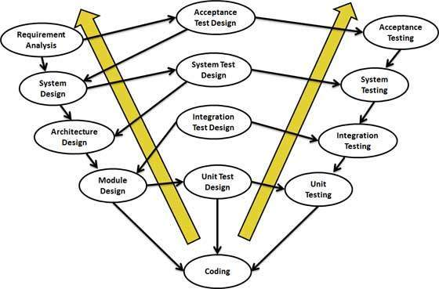
V-Model
V-Model:
In the V-Model, Unit Test Plans (UTPs) are developed during module design phase. These UTPs are executed to eliminate bugs at code level or unit level.

Slide 6
Agile
Agile Methodology :
In this methodology, requirement, design, and code changes are part of the process, and accommodating such changes are the basis of Agile.
You will never have complete and unchanging requirements and design documents from the start.
As the requirements and design change, you often have to change all your written unit test cases.
The scrum process is designed to handle changes in requirements coming from the product owner during the development process, so you may need to change the previously written unit code.
In the case of legacy products, the code base continues to increase over time, and changes to it can result in broken code. To confirm that the new development hasn’t broken the legacy code, you will need to do regression testing using your unit tests.

Slide 7
Unit Testing in Continuous Integration (CI) Environment
Continuous Integration (CI) is a development practice that requires developers to integrate code into a shared repository several times a day.
Each check-in is then verified by an automated build, allowing teams to detect problems early.
By integrating regularly, you can detect errors quickly, and locate them more easily.

Slide 8
Bamboo
Bamboo is a continuous integration (CI) server that can be used to automate the release management for a software application, creating a continuous delivery pipeline.
Builds and integration tests are automatically triggered as soon as a developer commits code (Continuous integration).

Slide 9
Features
Build-Create multi-stage build plans, set up triggers to start builds upon commits, and assign agents to your critical builds and deployments.
Test-Testing is a key part of continuous integration. Run automated tests to regress the products thoroughly with each change. Parallel automated tests unleash the power of Agile Development and make catching bugs easier and faster.
Deploy-Bamboo offers support for the "delivery" aspect of continuous delivery. Deployment projects automate the tedium right out of releasing into each environment, while letting you control the flow with per-environment permissions.
Connect-Bamboo boasts the best integration with JIRA Software, Bit bucket, Fisheye, and Hip Chat. Also, boosts CI pipeline.

Slide 10
Working Process
Bamboo first gets your source from a source repository
Then Bamboo starts the build - that can be done by calling something like for example, MS Build to build your Visual Studio solution.
Once your solution or project is built, you have "artifacts" (build results, for example, an executable app, config files, etc.).
You can do additional things with the build artifacts:
zip them up into a ZIP file and copy them somewhere.
run an install builder on them and create an MSI.
install them on a test server to make sure everything installs just fine.
Bamboo provides a web front-end for configuration and for reporting the status of builds.

Slide 11
Advantages
Bamboo provides
an automated build and test process thereby reducing the need to code.
manage builds that have different requirements or targets.
A build and test process, which is not dependent on a specific local environment.
Using bamboo one can
optimize build performance through parallelism.
leverage elastic resources.
deploy continuously, for example to user acceptance testing (UAT).
implement release management.

Slide 12
NUnit Testing
As we discussed earlier, NUnit is a unit-testing framework for .NET applications in which the entire application is isolated into diverse modules.

Slide 13
SVN
Apache Subversion , often abbreviated SVN, is a software versioning and revision control system.
Software developers use Subversion to maintain current and historical versions of files such as source code, web pages, and documentation.
It allows to track changes in files and directories
It allows concurrent development on the same files
It is Centralized

Slide 14
SVN Life Cycle
Create Repository:
The 'create' operation is used to create a new repository. Most of the times this operation is done only once.
Checkout:
It is used to create a working copy from the repository. Working copy is a private workplace where developers do their changes, and later on, submit these changes to the repository.
Update:
It is used to update working copy. This operation synchronizes the working copy with the repository. As it is shared by all the teams other developers can commit their changes and your working copy becomes older.
Commit Changes:
It is used to apply changes from the working copy to the repository. This operation modifies the repository and other developers can see these changes by updating their working copy.
Before commit, one has to add files/directories to the pending change-list. This is the place where changes wait to be committed. With commit, we usually provide a log message to explain why someone made changes. This log message becomes a part of the history of the repository. Commit is an atomic operation, which means either the entire commit succeeds or it is rolled back. Users never see half-finished commit.

Slide 15
MSTS (Microsoft Test suit)
MTM stores Our test plans and results on Team Foundation Server (TFS).
If you don’t need all the features of Microsoft Test Manager, you can use the web portal to plan and run your tests.
The web portal lets you create test cases and organize them into test plans and suites. When you perform a test, the web portal displays the test steps and lets you mark which steps passed or failed.
In addition, Microsoft Test Manager can record your actions, screenshots, Intellitrace logs and other diagnostic data. It also lets you manage lab environments.
But you don’t have to decide upfront - you can always use either tool to edit your test plans or run your tests.

Slide 16


